Slide 1
Vehicle and Pedestrian Detection Technologies
Virtual Traffic Engineering and Safety Conference
October 22, 2020
1

Slide 2


Presenters
2

Slide 3
History of Detection for What?
Security
Traffic signal intersection control
Incident
Vehicle counting
Pedestrian counting
3

Slide 4
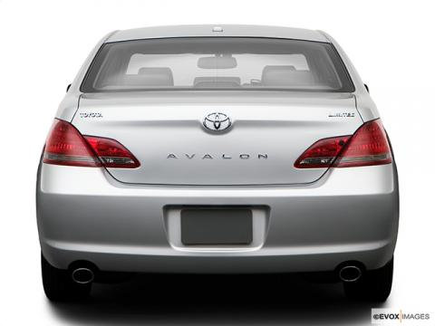
How did Intelligent Transportation Systems see the vehicles 25 years ago?
Vehicle shapes
Metal-reflection
Heat
Engine Acoustics
Video Pixel Changes
Metal magnetic field presence
License Plates
Weight/pressure
The vehicle in 1995
4

Slide 5
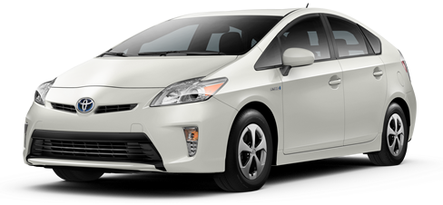
How do the new Intelligent Transportation Systems see the vehicles today?
Vehicle Diagnostics:
Bluetooth
Hands free-sets:
Bluetooth
Mobile phones:
Bluetooth
GSM
Vehicle Tags:
RFID
Micro wave
Bluetooth
GPS Navigation Systems:
Bluetooth Floating Vehicle (GPRS)
Portable PC / PDA:
Bluetooth
WiFi
The vehicle in 2020
V2X Communication:
5

Slide 6
Brief History
What technologies have been used?
  Sound
  Treadles
  Inductive loop
  Ultrasonic – Radar, Microwave
  Magnetic
  Video imagining
  Thermal Imaging
6

Slide 7
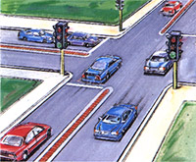
Signal Intersection Control
7

Slide 8
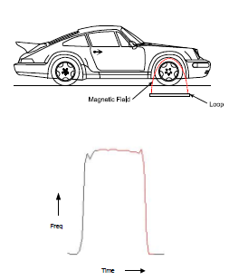
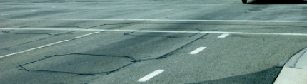
Signal Intersection Control
Inductive loops
  Only detects metal Objects
8

Slide 9
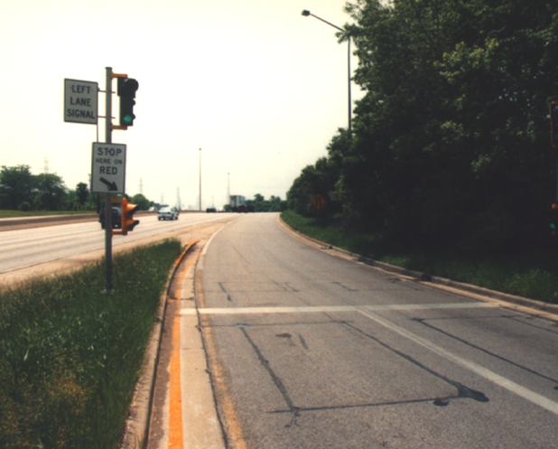
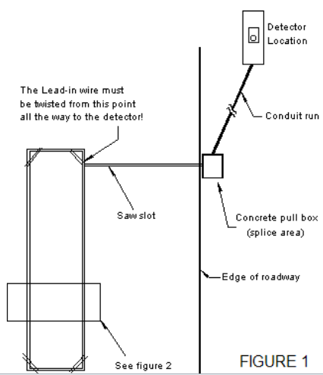
LOOP Detectors – Ramp Metering
9

Slide 10
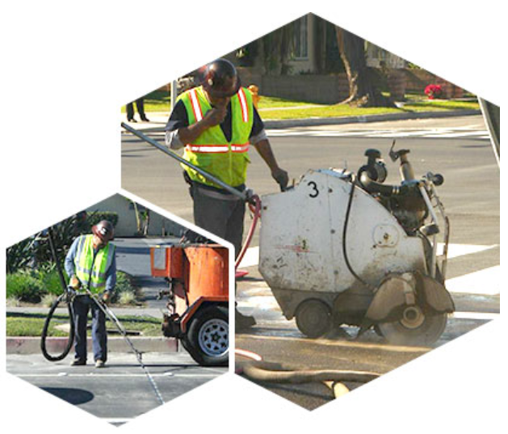
Inductive Loop
Advantages
  Accurate
  Accepted technology
  Field proven
  Installation requires no new equipment
Disadvantages
  Labor intensive to install
  Requires traffic control to install
  No ability to relocate
  Pavement life determines loop life
  Needs to be on diggers hotline
10

Slide 11
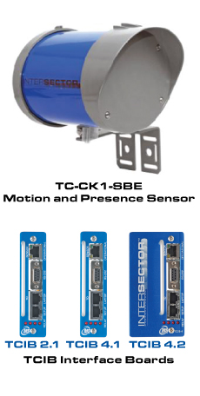
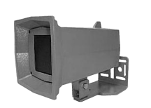
Microwave Detection
11

Slide 12
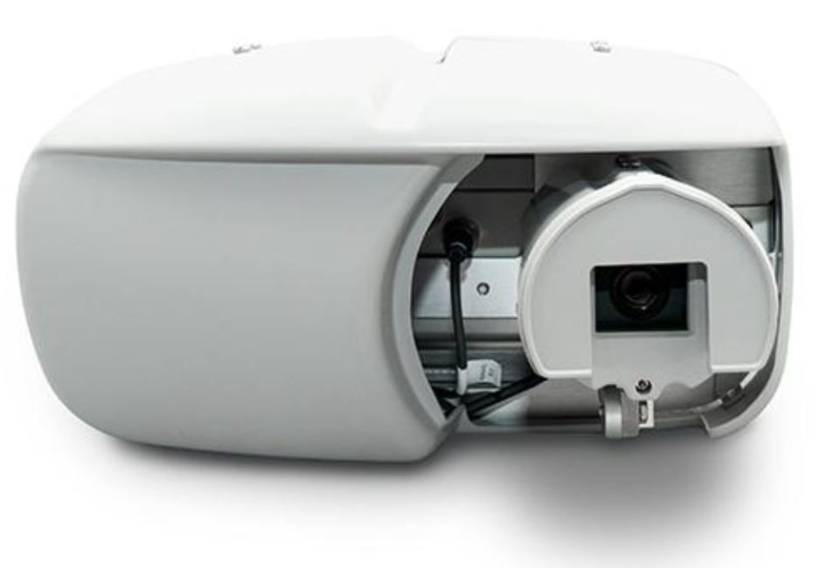
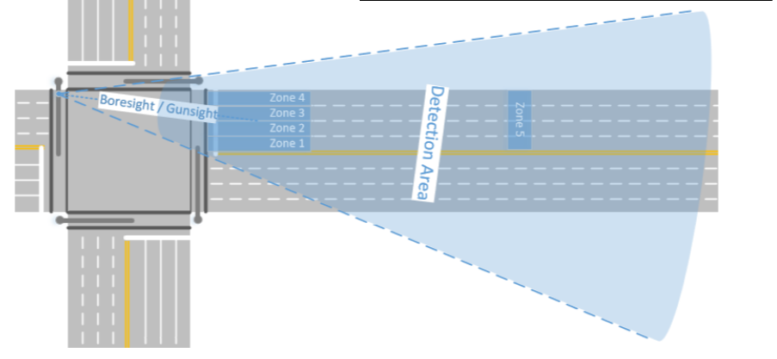
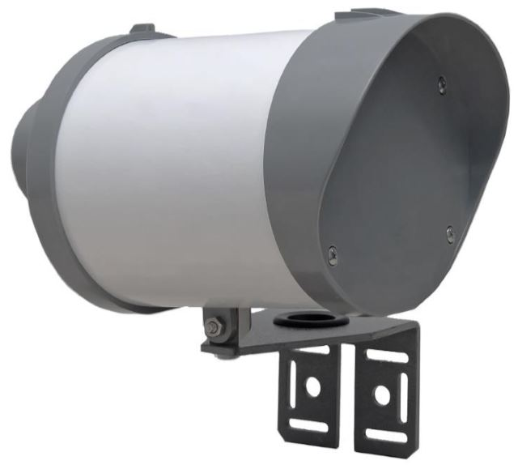
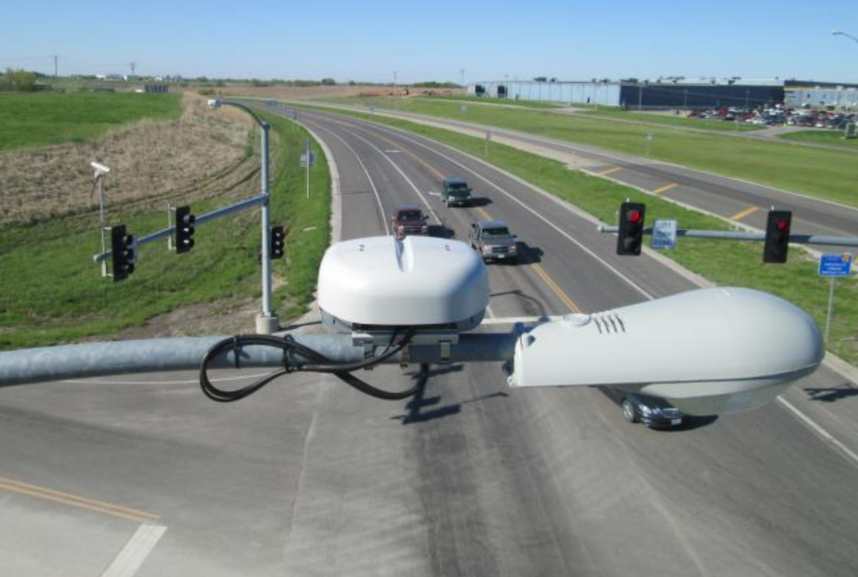
Microwave Detection Advancements and Combo
12

Slide 13
Microwave Detection
      Advantages
        Low cost
        Easy to install
        Aim for zone
      Disadvantages
        Unpredictable zone coverage
        Limited range
        Need for fixed mounting
        Presence detection requires logic
13

Slide 14
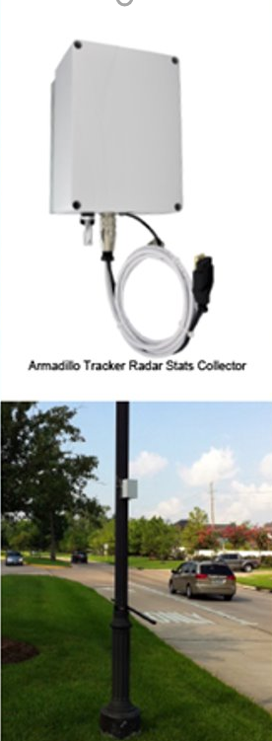
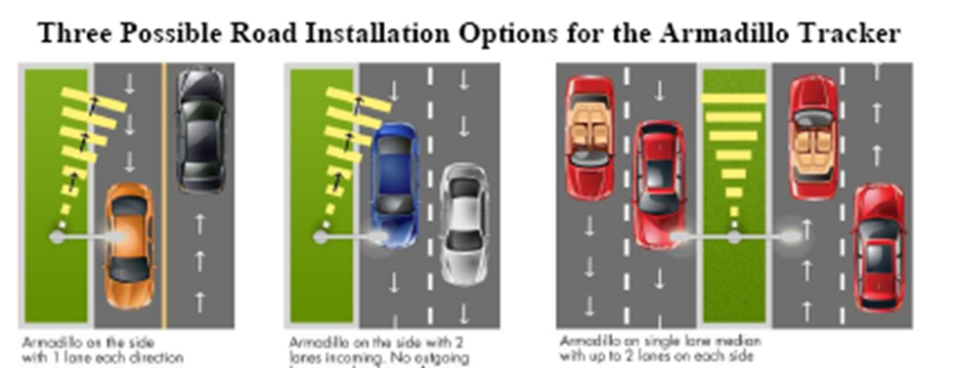
Microwave Detection
      Counting
        Simple
        Inconspicuous
        Before and After
14

Slide 15
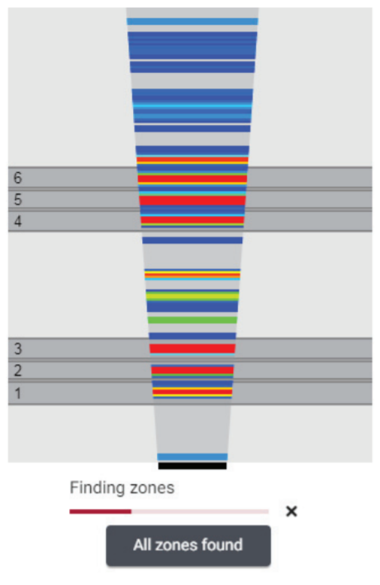
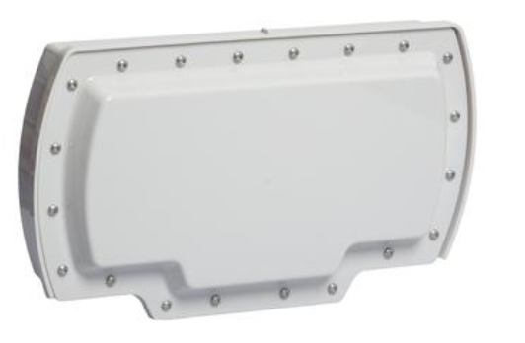
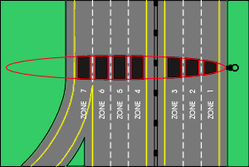
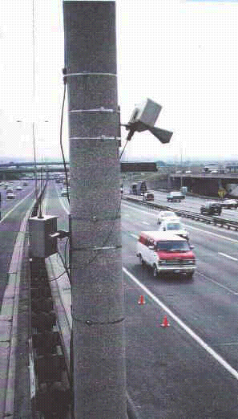
Multi-lane Microwave Detector
15

Slide 16
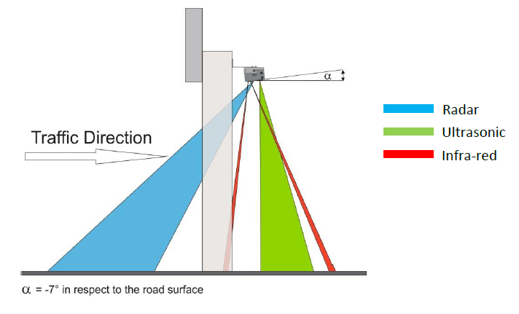
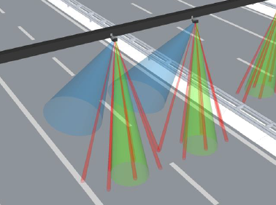
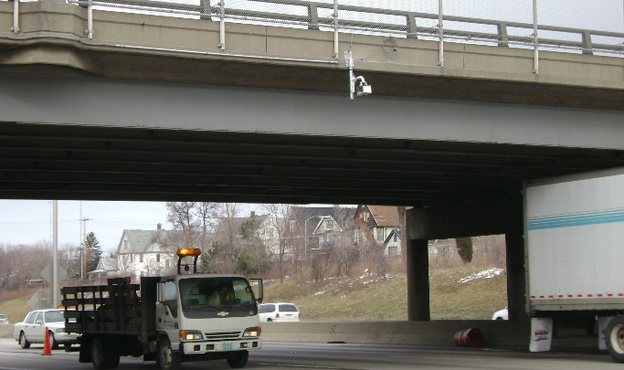
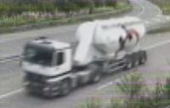
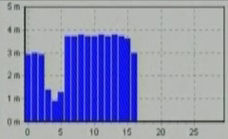
Triple Beam Technology
16

Slide 17
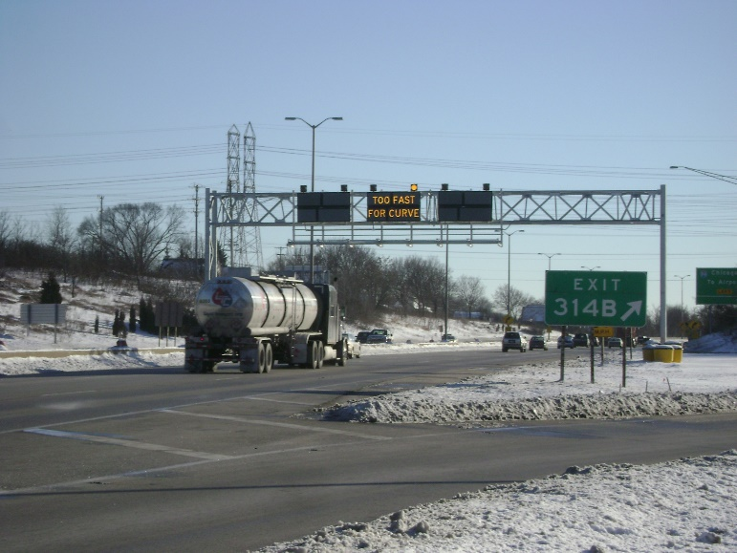
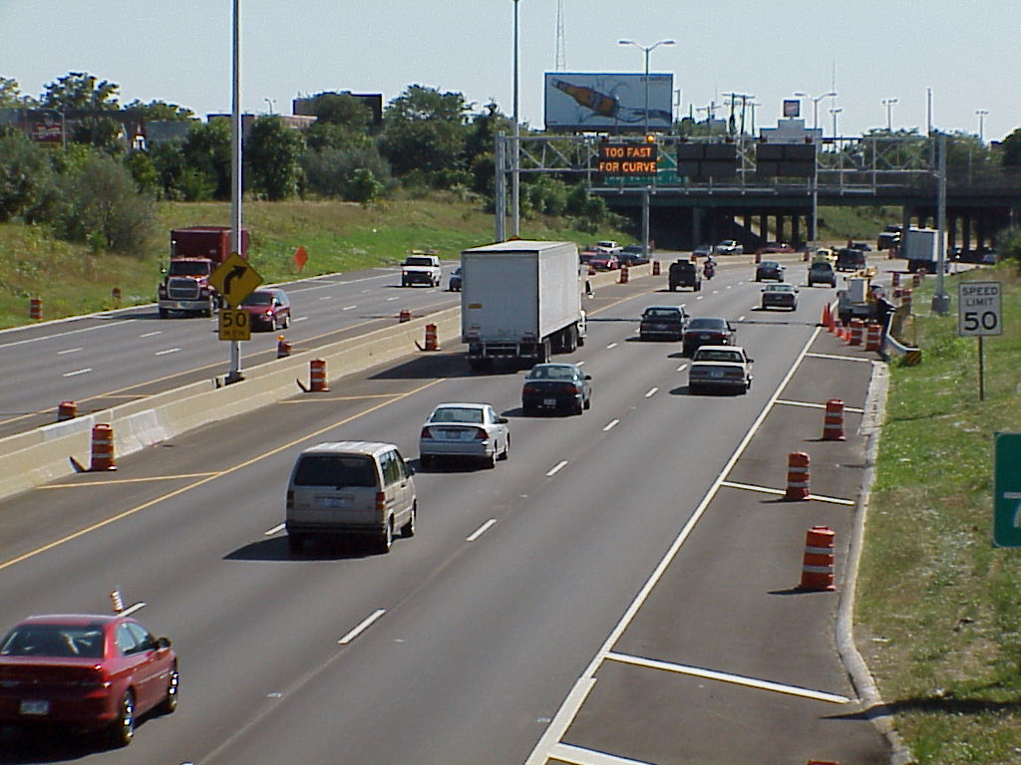
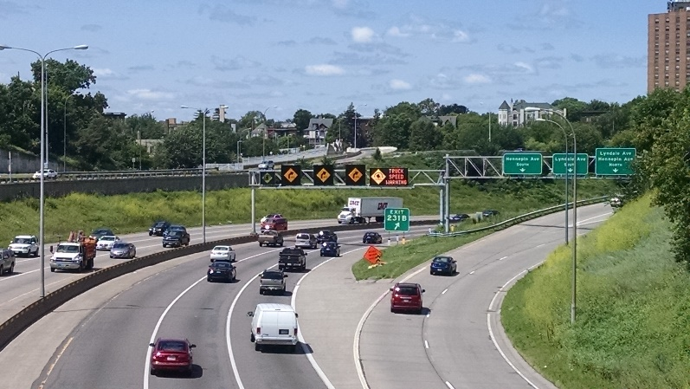
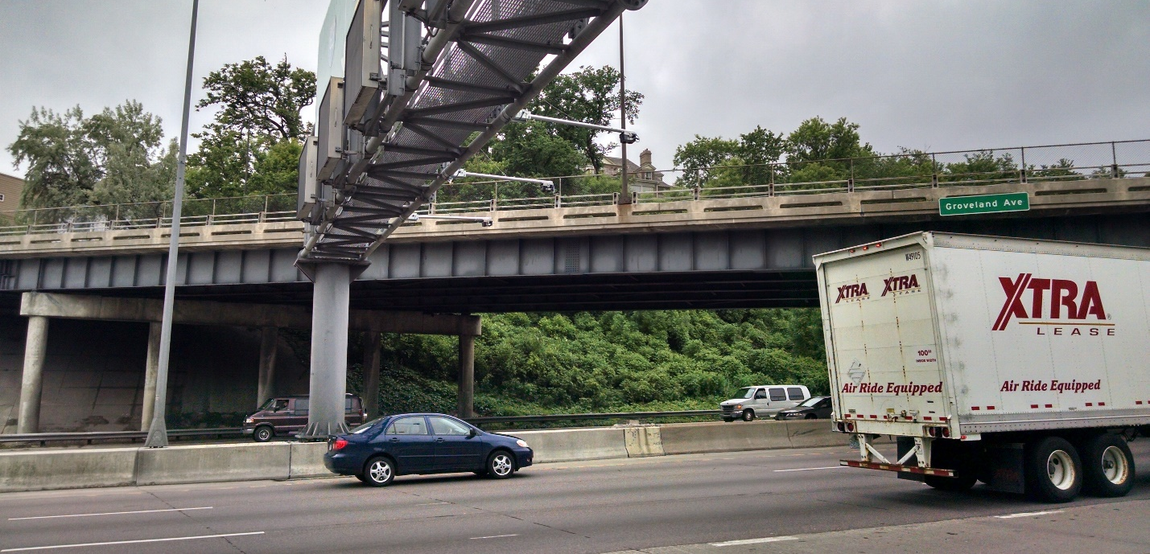
Triple Beam Technology
17

Slide 18
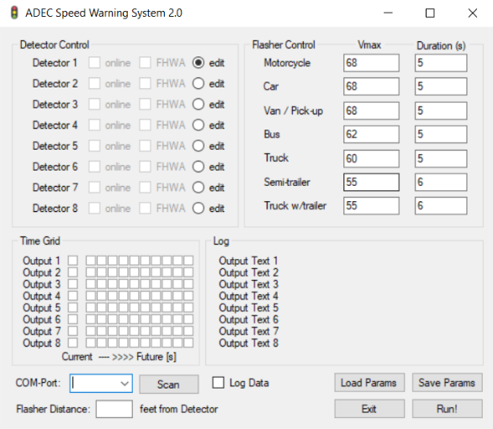
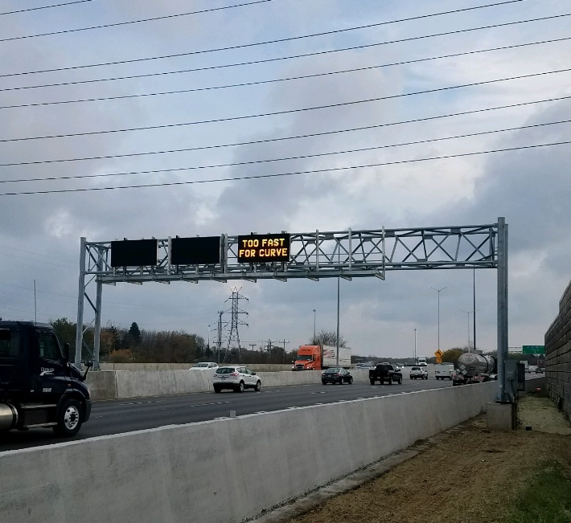
Classifications Details and Controls
18

Slide 19

Magnetometers Detection
19

Slide 20
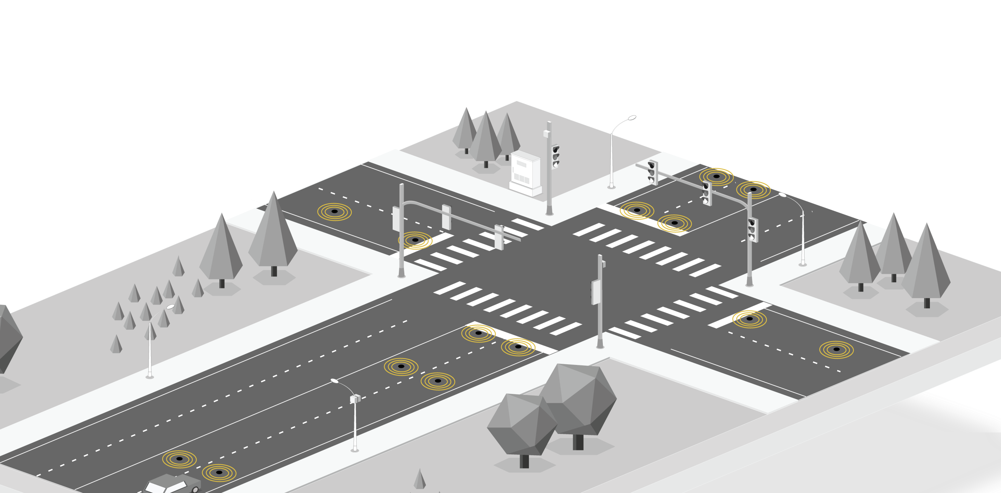
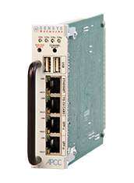
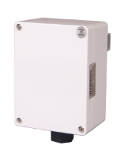
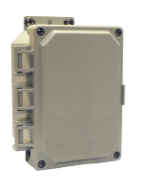
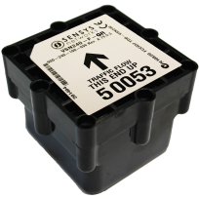
      Wireless Magnetometer
APCC
SPP Digital Radio
Repeater
Sensors
20

Slide 21
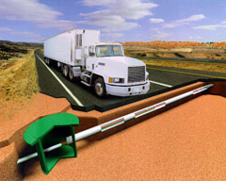
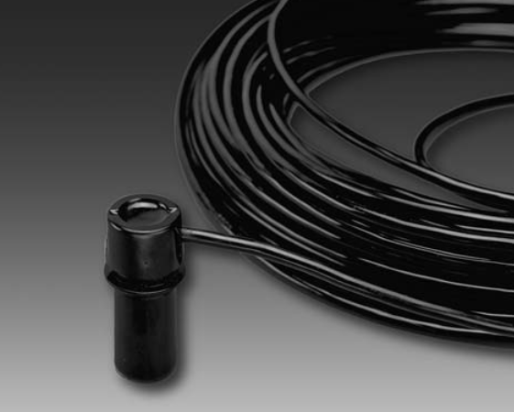
More Alternatives
      Microloop (wired magnetometer)
21

Slide 22
Magnetometers Detection
      Advantages
        Wireless to cabinet
        Core drill only
        Specific point detection
        Good temporary installation features
      Disadvantages
        Complex to setup
        Limited range
        Site survey required
        Battery replacement required
        Small detection footprint
22

Slide 23
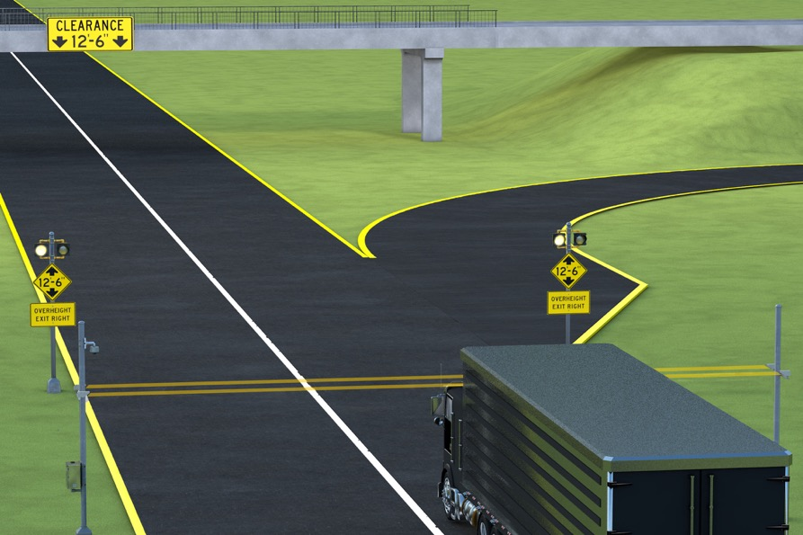
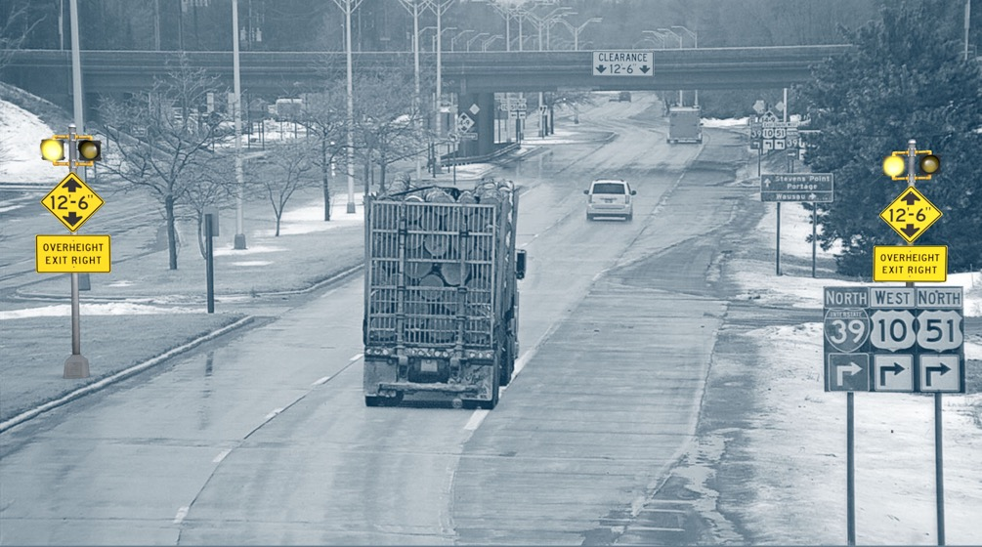
Overheight Warning Break the Beam
23

Slide 24
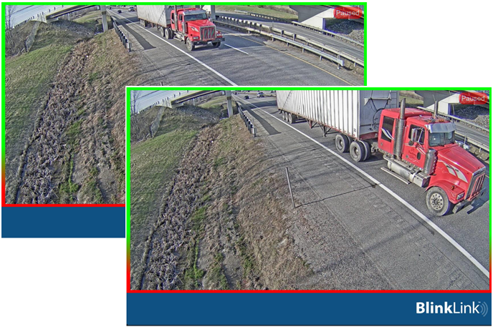
Overheight Warning Break the Beam
24

Slide 25
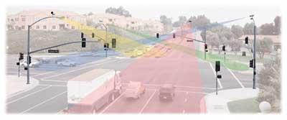
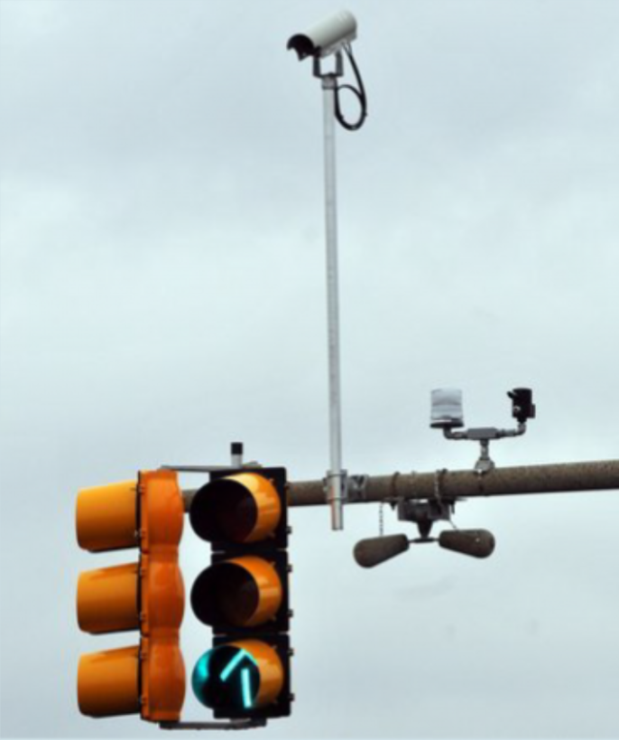
Video Detection
25

Slide 26
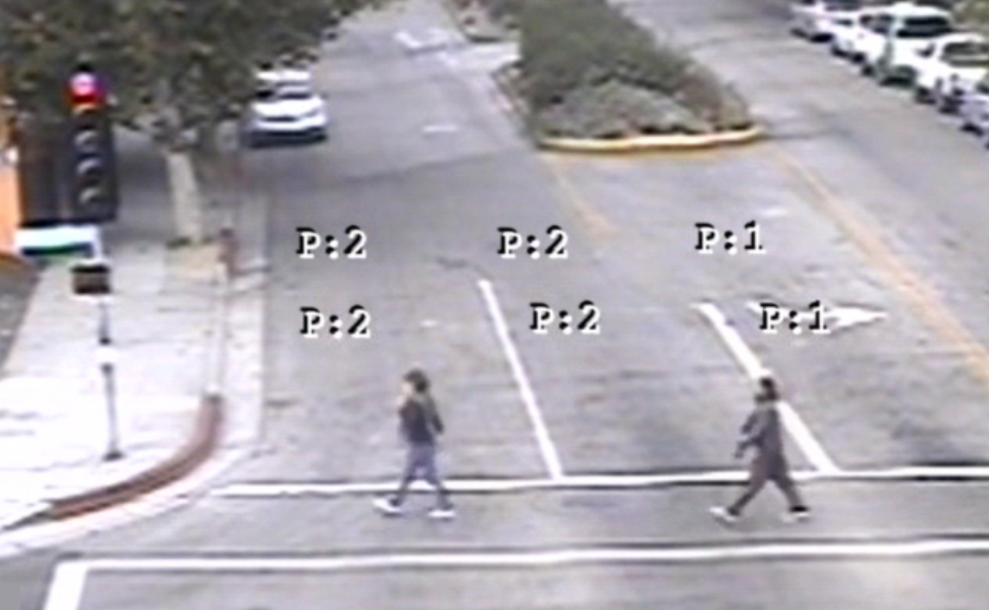
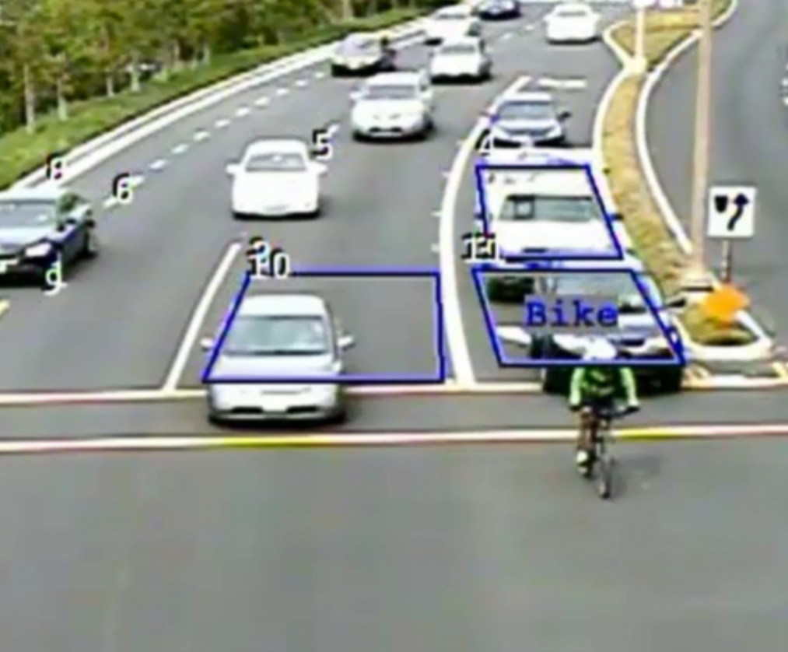
Video Detection
26

Slide 27
Video Detection
      Advantages
        No diggers hotline
        Flexible zone configurations
        Lower cost than loops
        Pedestrian / Bicycle Detection
        Good zone coverage w/ single camera
      Disadvantages
        Camera Occlusion can occur
        Fixed mounting required
        Need to see for detection to work
27

Slide 28
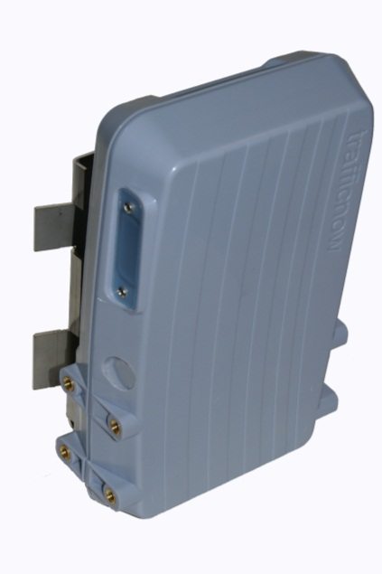


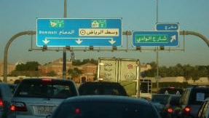
Bluetooth Technology
The Bluetooth channel is used for data transmission for a limited amount of data; the channel is efficient and cost effective. Bluetooth communication is used by mobile telephones, hands-free sets, GPS navigators and more. All these Bluetooth emitting devices leave a unique digital footprint. As the vehicles circulate the Bluetooth Sensor will pick up these signals and track the path of the vehicles. With a significant percentage of the passing vehicles providing a Bluetooth signal the sensors will provide very, very accurate traffic information.
BLUETOOTH SENSOR
MOBILE PHONES, GPS, PDA, HANDSFREE SETS
28

Slide 29
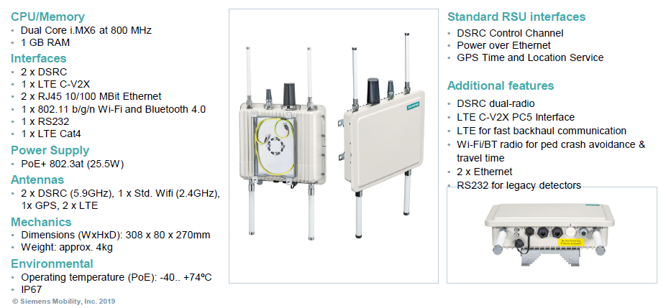
Road Side Units – DSRC, C-V2X, with BlueTooth
29

Slide 30
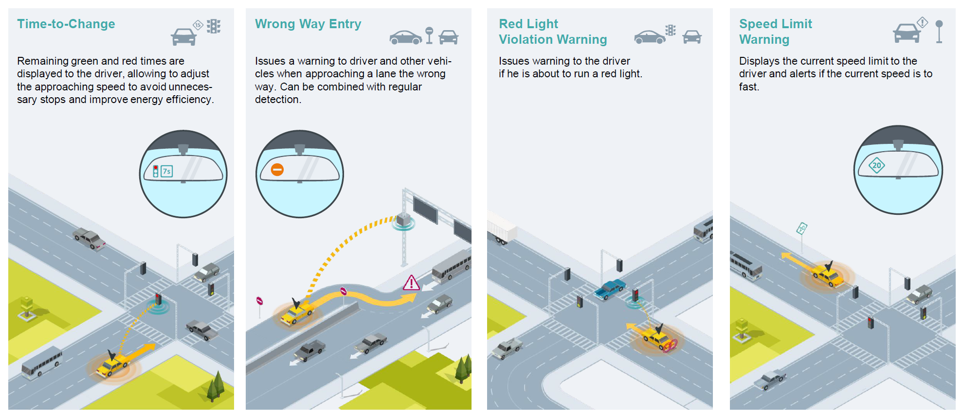
Road Side Units – DSRC, C-V2X
30

Slide 31
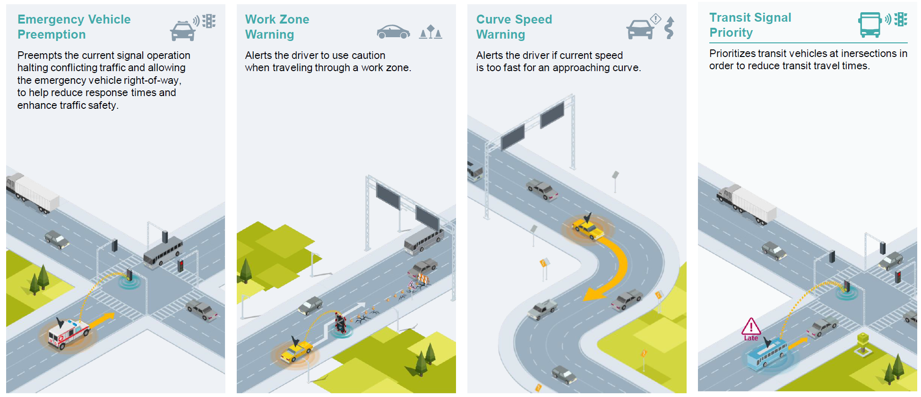
Road Side Units – DSRC, C-V2X
31

Slide 32


Connected Vehicle Interface
    Alert connected vehicles that a pedestrian has activated the crosswalk system –drivers to be on the lookout for pedestrians
32

Slide 33

Intersection Stop Warning – Various Improvements
33

Slide 34


Thermal Applications
Wrong Way Driver
Accurate wrong-way vehicle detection
Multiple lanes of detection
Pedestrian Crosswalk
Accurate pedestrian and bike detection
Multiple zones of detection
34

Slide 35




Rational
What is Thermal Technology
A thermal sensor produces an image derived from invisible infrared waves, also, simply known as heat.
Thermal sensors detect this heat and convert it into an electronic signal which is ultimately processed to produce a thermal image that is viewable by the human eye.
35

Slide 36
Advantages of Thermal
At night and in complete darkness
Through shadows and sun glare
In all weather conditions including fog, rain and snow
Easy set up and configuration with no road shut down necessary
24/7 fast, reliable and
accurate detection
Configurable zone settings to help with troublesome layouts
36

Slide 37



Thermal Wrong Way Applications
OFF-RAMP
Initial Detection
Wrong Way Detection
OFF-RAMP
& MAINLINE
MAINLINE
37

Slide 38





Pedestrian Thermal Images
Presence
Directionality
Configuring a Zone
38

Slide 39


Passive or Active Infrared Detectors
    Pedestrian Detection Sensors
      Infrared and/or microwave sensors​
      Presence and/or motion activates crosswalk system​
39

Slide 40
Infrared Detection
      Advantages
        Specific point detection
        Low cost
        Easy to set up
        Good versatility
      Disadvantages
        Distance limiting
        Fixed mounting required
40

Slide 41

Pedestrian Detection Bollards
    Considerations
      Use of infrared (IR) technology
        Dual IR beams
          Beam break order determines directionality and system activation
    Uses
      For Vulnerable Road Users (VRUs) who may not press the push button
      Corral pedestrians
      Activation further away from crosswalk
41

Slide 42


Time Clock
Activate crosswalk (or school zone) alerts during specific time periods
Time activated switch – manual scheduling inside the cabinet
Remote scheduling through cloud based software
42

Slide 43


Pedestrian Push Buttons
Mechanical push buttons have historically been used for pedestrian system activation
Image is of a piezo, not mechanical, push button
43

Slide 44


Push Button Improvements
Push button technology has improved over the years
  Piezoelectrical
  ADA-compliance
  Accessible
  Audible
  Touchless
  Bluetooth
44

Slide 45



Push Button Improvements
    Audible push buttons
      Notification to let pedestrians know the call has been received
      Audible messages to notify pedestrian of walk sign, or that the warning lights are flashing
    Bluetooth
      There are now products with applications on the market where pedestrian can activate signalized and unsignalized crossings
45

Slide 46
Smart Cameras and Software
    Visual software is evolving to use different technologies to detect pedestrians and even predict pedestrian movements
      Extend green light time for bikes
        Also bikes can ask for green via apps
      Extended walking time for pedestrians
        Based on pedestrian density
46

Slide 47
Any Questions?

Slide 48
Contact Information
48

