Slide 1
Highway Incident Management Training
Geno Koehler

Slide 2
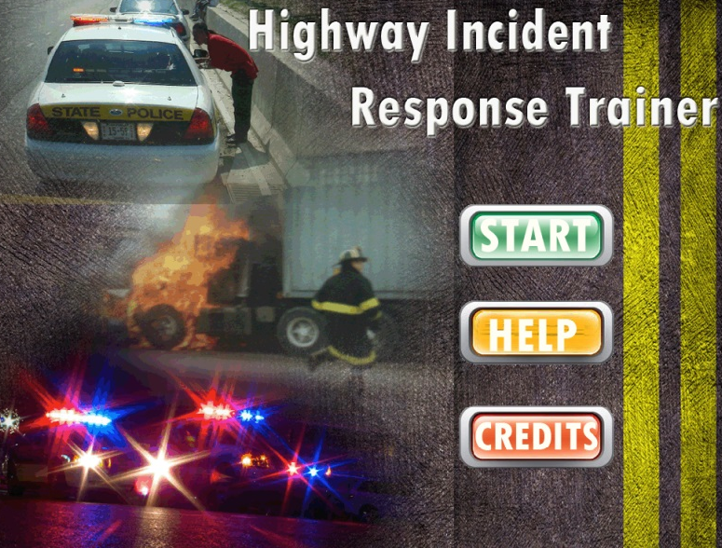
Overview
Introduction
In-Class Modules
Online Modules
Training Games
Conclusions

Slide 3
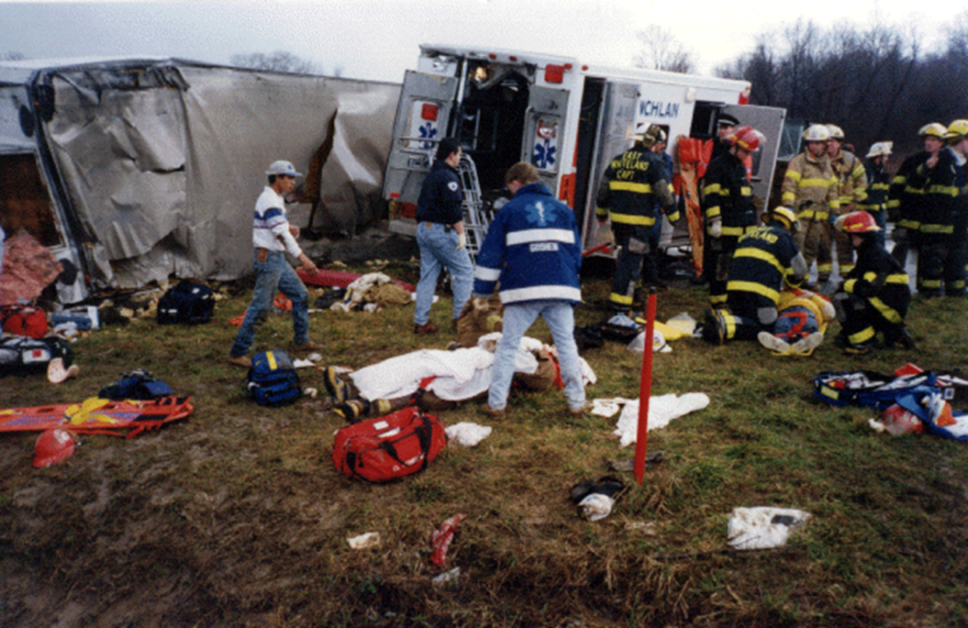
Introduction
Developed to reduce responders fatalities
Funded by IDOT and ICT
Developed by Southern Illinois University Edwardsville (SIUE)
Source: WISDOT

Slide 4
Need Assessment
Who trains with other agencies?
Notes:
Key Message: The survey results by SIUE indicated that there is 50% incident responders never trained with other agencies; 19% trained with 1 agency, 16% trained with 2-3 agencies; only 12 % trained with 4-5 agencies and 3% with more than 5% agencies. The lack of multi-agencies training course is one of main reasons.
Background Information: The survey conducted for the incident responders in the State of Illinois including ISP, Fire, Transportation, Tollway, Towing and Recovery. Total 1370 people responded to the survey.
Interactivity: Ask if anyone in the classroom remembers responding to the survey sent out in 2009?

Slide 5
Key Stakeholders
Illinois Department of Transportation
Illinois State Toll Highway Authority
Illinois State Police
Federal Highway Administration
Office of the State Fire Marshal
Towing and Recovery Association of America

Slide 6
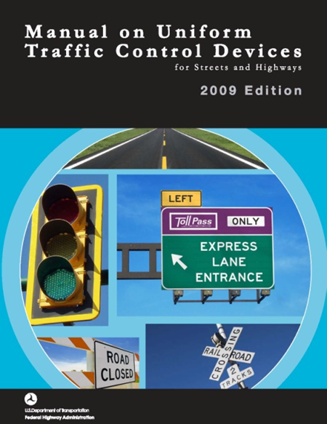
Development
Project began in 2009
Objectives
Reduce secondary crashes
Follow NIMS guidelines
Follow MUTCD guidelines
Include legal options
Include operational agreements

Slide 7
Target Audience
Law Enforcement
Patrol, Supervisors, Accident Investigators/Reconstructionists
Fire Department
Fire personnel, Officers, Rescue/Extrication crews, HazMat teams
Emergency Medical
Duty personnel, Supervisors, Air Medical crews
Tow & Recovery Operators
Light-, Medium-, & Heavy-duty Operators, Supervisors
Highway Department
Municipal, County, State DOT, Courtesy Patrol, Tollway
Communication
911 Centers, Traffic Operations Centers,
Transportation Management Centers (TMC)
Notes:
Key Message: “ who should attend this training…”
Background Information: estimated number of audience from each agency in the Illinois…
Acronym: ISP = Illinois State Police; ETP = Emergency Traffic Patrol; EPV = Emergency Patrol Vehicle
Interactivity: Ask students raise their hands when discuss each group of audience; identify the Illinois state agencies for each discipline.
Notes: Law Enforcement 20+ members, Fire Departments 20+ members, Emergency Medical Services 10+ members, Towing and recovery 2+ members, Highway Departments 25+ members, Communications 2+ members

Slide 8
In-Class Modules
Module 1: Introduction
Module 2: Role and Responsibilities
Module 3: 3C’s
Module 4: Initial Scene Response
Module 5: Incident Classification
Module 6: Traffic Management
Module 7: Clearance/Termination
Module 8: Case Studies and Table Top Exercises

Slide 9
Online Modules
Module 10: Introduction to Incident Management
Module 20: Laws and Policies
Module 30: Highway Terms
Module 40: Roles and Responsibilities
Module 50: Incident Classification
Module 60: Temporary Traffic Control I
Module 70: Temporary Traffic Control II
Module 80: Introduction to Safe Parking
Module 90: TRAA Vehicle Classification
Module 100: Electric Vehicle Training
Module 110: Cable Stay Systems

Slide 10
Training Game

Slide 11
Traffic Incident Management Challenge
Educate users who are new to highway parking
Refresh knowledge for those who have been working for years
Provide safe ways to test highway parking procedures
Encourage user ability to interact with others while responding

Slide 12
Conclusions
SHRP II compliant
Endorsed by the FHWA in 2012
Improved the safety of responders

